Slide 1







https://cibig-wave.github.io
Mentoring Project
October 21, 2024 – November 25, 2024
Theme: Population structure within Magnaporthe oryzea
Attendees
Attolou Raoul AGNIMONHAN
Pakyendou Estel NAME
Tutors
Aurore COMTE
Sébastien RAVEL
<numéro>

Slide 2
PLAN
BACKGROUND
OBJECTIVES
BIOINFORMATIC STRATEGY
RESULTS & DISCUSSION
CHALLENGES
CONCLUSION
PERSPECTIVES
<numéro>

Slide 3
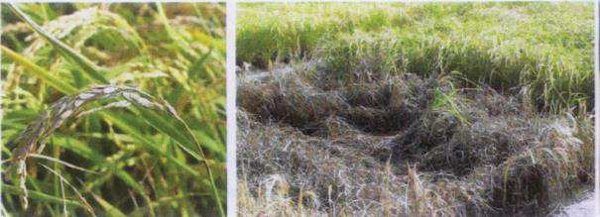
BACKGROUND (1/2)
Magnaporte oryzae (synonym of Pyricularia oryzae) is an ascomycete hemibiotrophic fungus that cause blast disease.
Blast is one of the most serious and devastating diseases caused by fungal pathogen. As such, it is a major threat to global food security (Khush and Jena 2009).
Rice Production : 30%–100% loss each year (Mutiga et al., 2021)
Blast disease is documented on more than 50 cultivated plant species
rice (Oryza sativa), wheat (Triticum aestivum),
barley (Hordeum vulgare),
ﬁnger millet (Eleusine coracana) etc.
Field damage in the Camargue. Photos: JB Morel, INRAE
2

Slide 4
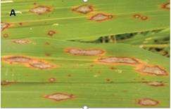
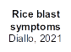
BACKGROUND (2/2)
M. oryzae, ﬁrst plant pathogenic fungus to be completely sequenced (Dean et al., 2005)
High genetic variation of M. oryzae was found in populations from
South, East and Southeast Asia,
which is more diverse than in other continents (Zeigler, 1998)
Study based on microsatellites markers supported this observation
Asia was the center of origin of M. Oryzae (Saleh et al., 2014)
Advances in high-throughput genomic sequencing have enhanced single
nucleotide polymorphism (SNP) discovery.
3

Slide 5


OBJECTIVES
We aim to understand the structure of M. oryzae populations
What is the link between host and population structure?
Are there cryptic species within M.oryzae ?
4

Slide 6
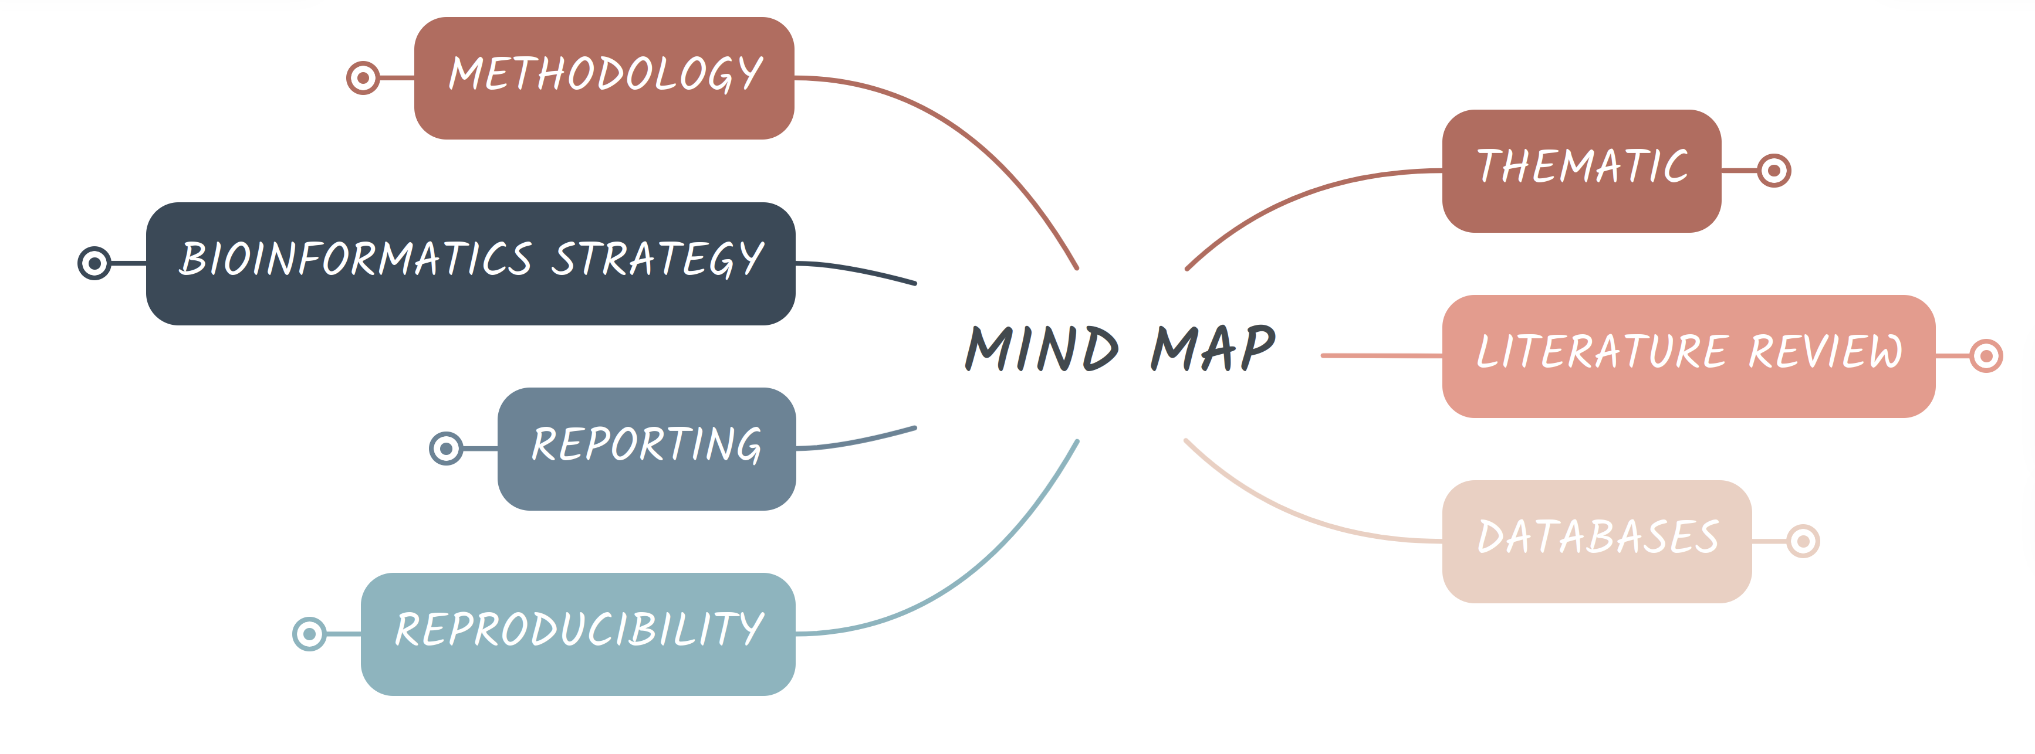

MIND MAP
Orgnanization for data analyzis : Mind Map
5

Slide 7
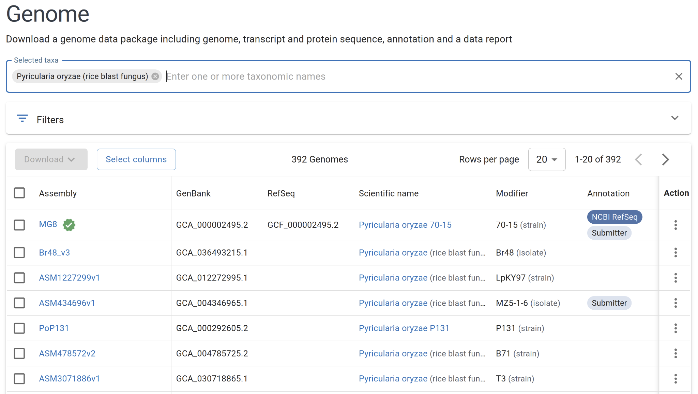
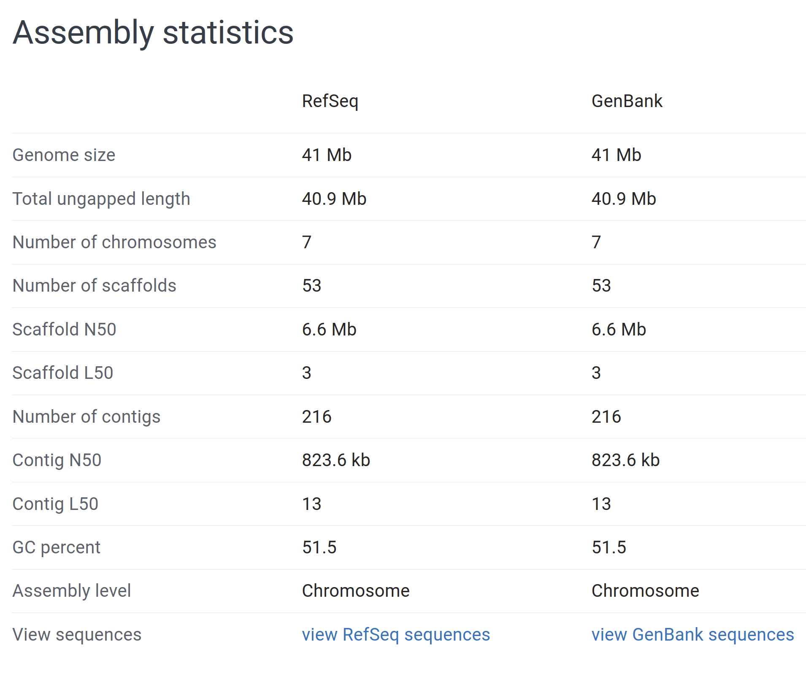
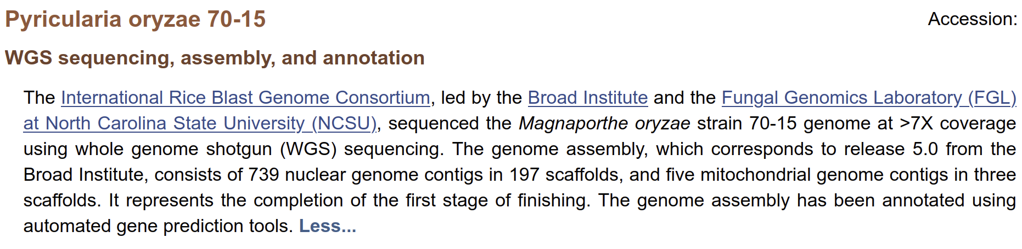
DATABASES & BIBLIOGRAPHY (1/2)
6

Slide 8

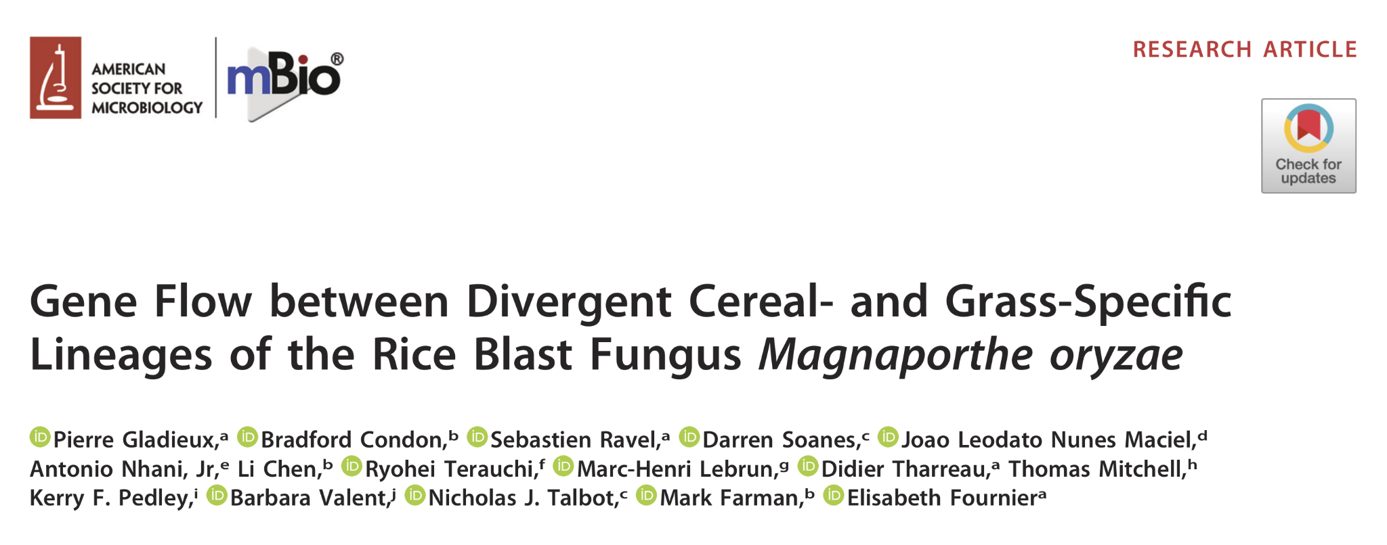
DATABASES & BIBLIOGRAPHY (2/2)
7

Slide 9
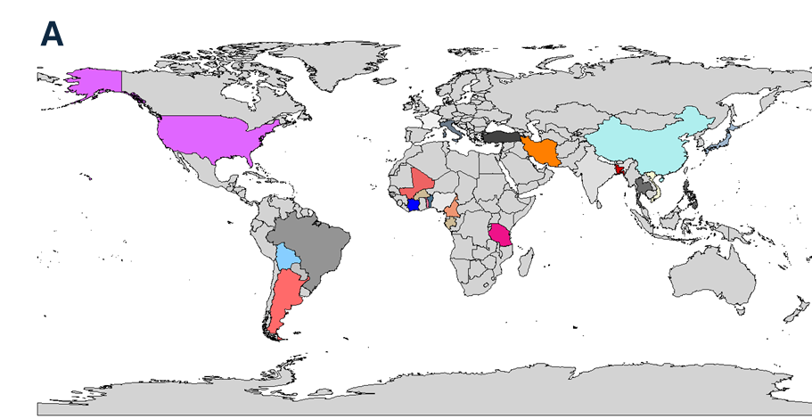
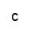
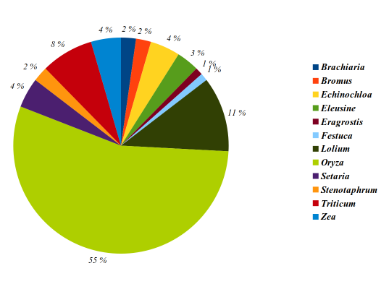
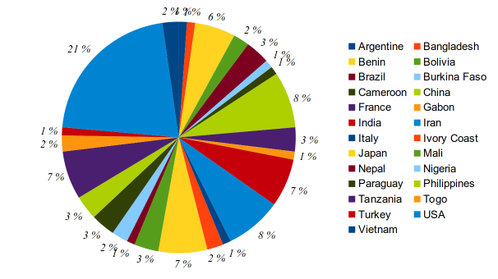
BIOINFORMATIC STRATEGY (1/3)
Datasets
Isolates : 89
Host genus : 12
Countries : 27
Year: 1958- 2017
Sequencing technology: Illumina Miseq, Illumina HiSeq, Solexa & 454.
Type of sequencing : paired-end
A
B
C
Figure 1 : (A)Map indicating 27 countries where the M.Oryzae were collected . Abbreviations (Codes ISO 3166-1) (B)Pie chart showing the number of M.Oryzae isolates reported from each country, (C ) host plant of the study
8

Slide 10
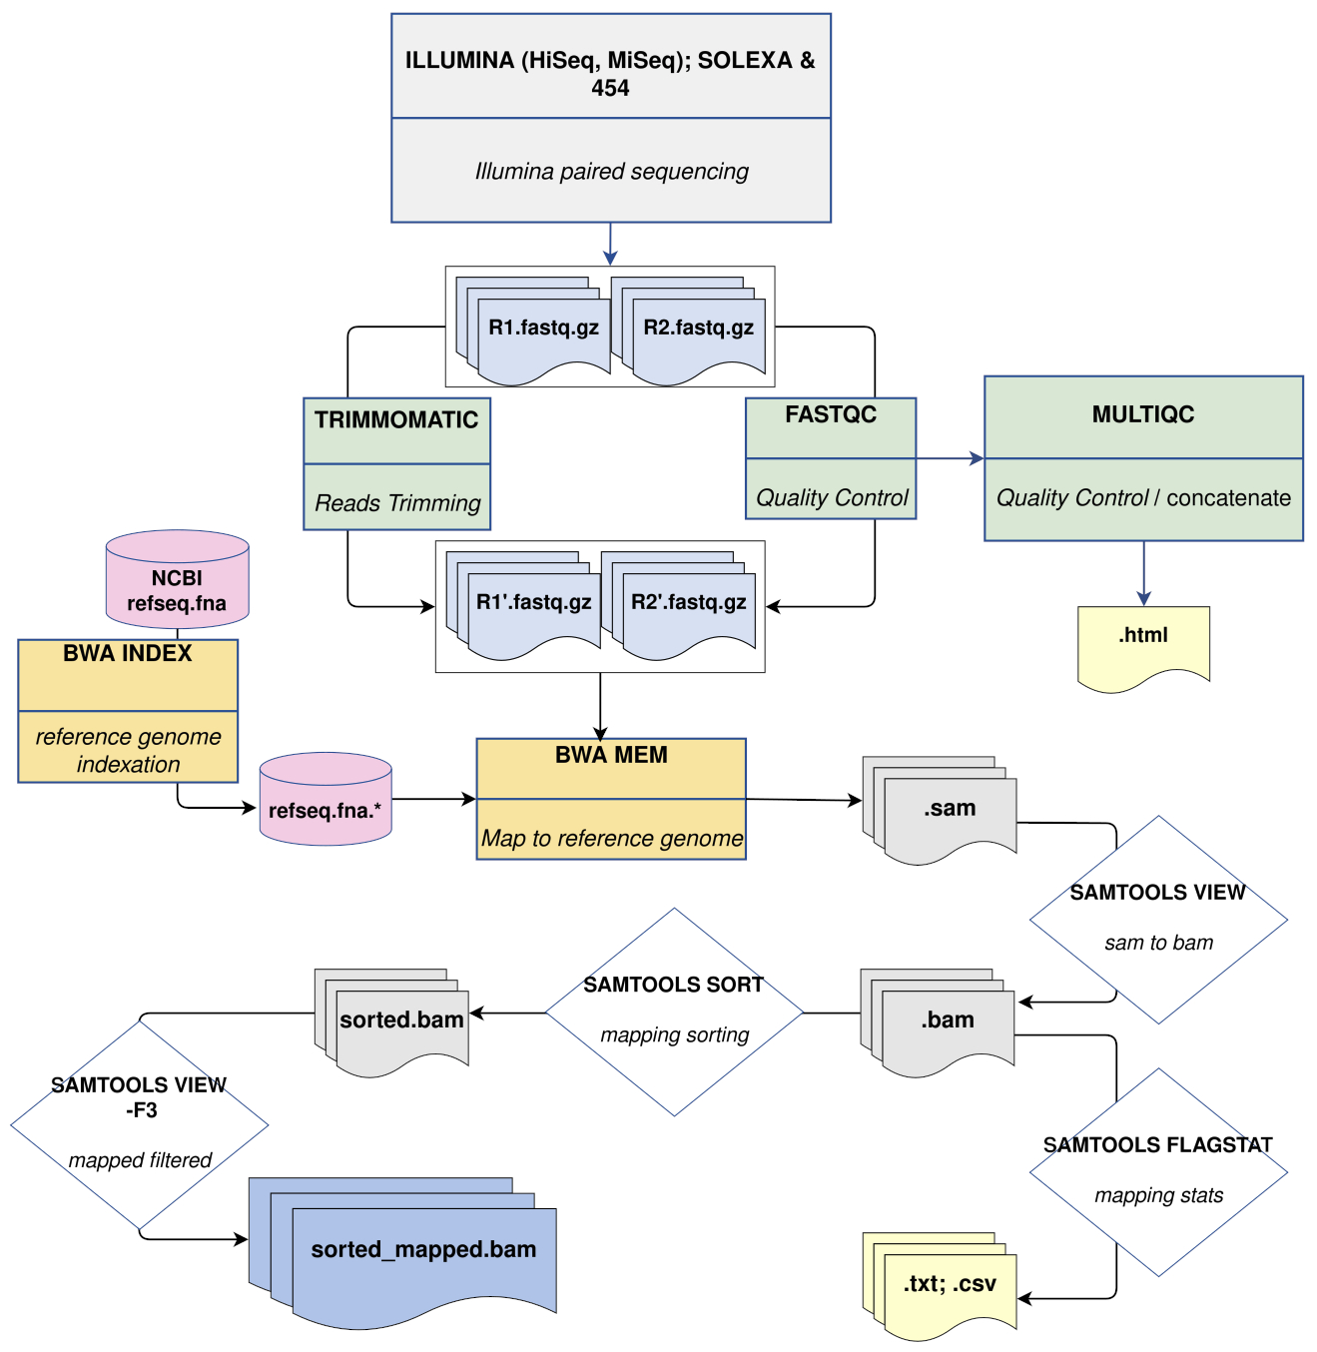

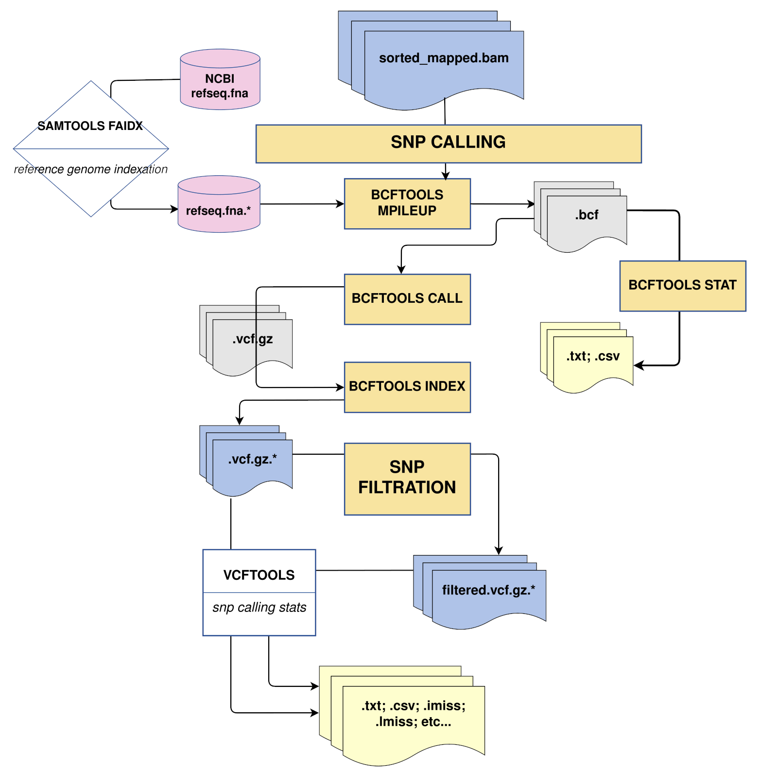

BIOINFORMATIC STRATEGY (2/3)
SNPcalling
& Filtering
QC & Mapping
9

Slide 11

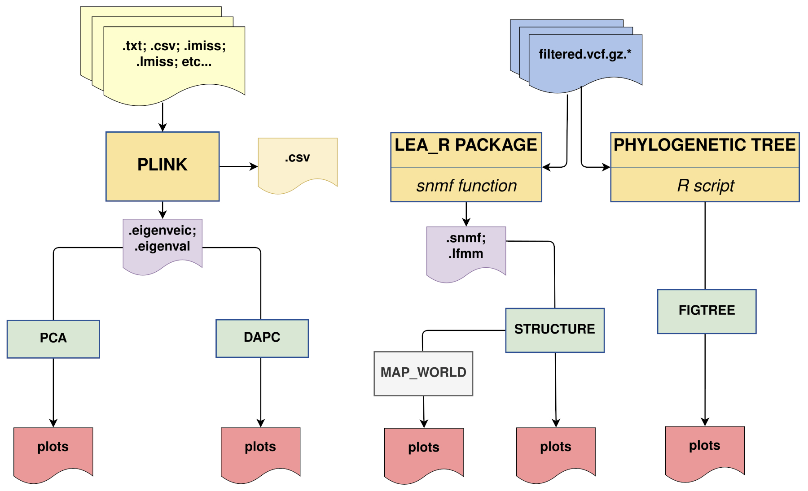
BIOINFORMATIC STRATEGY (3/3)
PCA
DAPC
GENETIC STRUCTURE
10

Slide 12
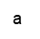
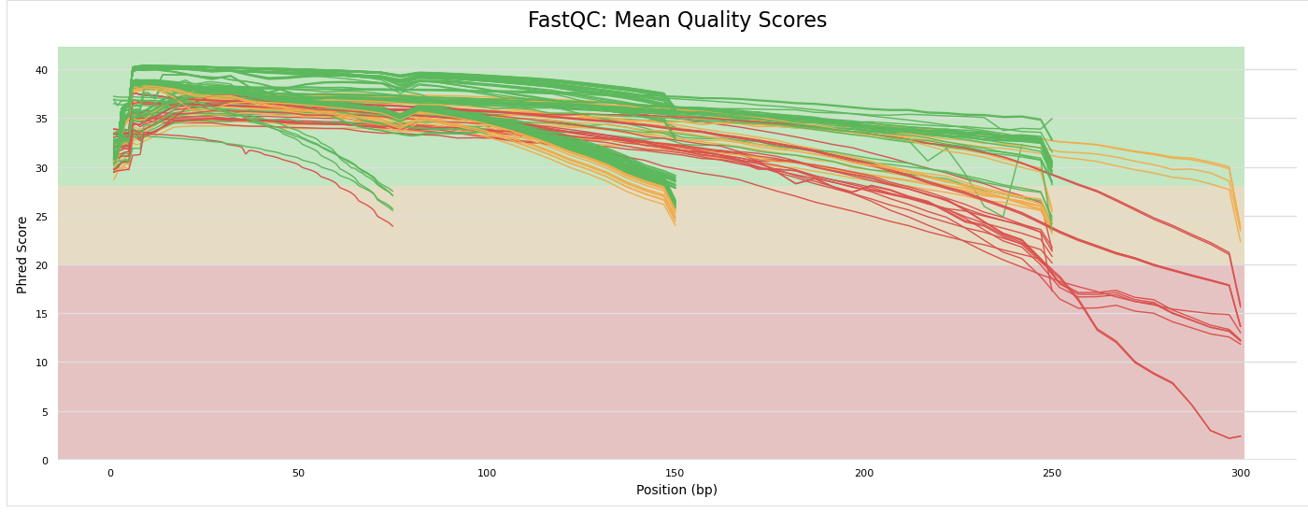
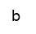
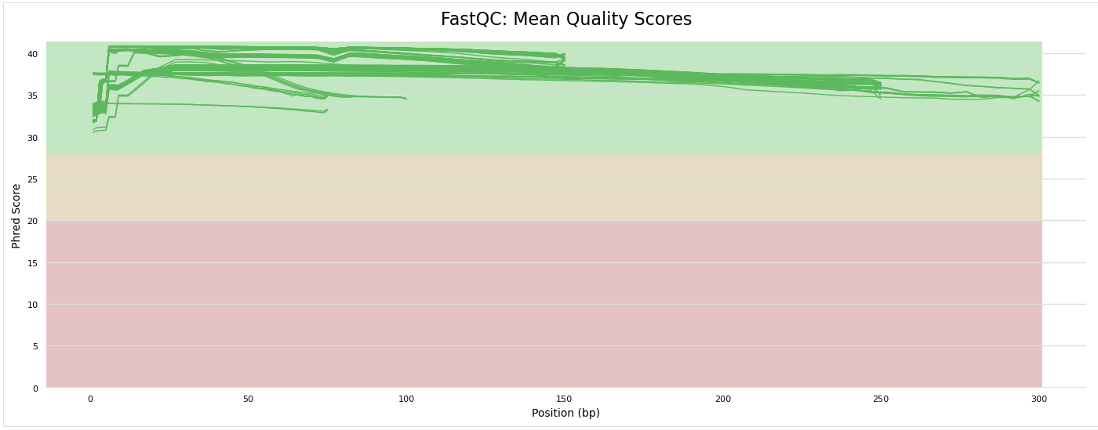
RESULTS & DISCUSSION (1/9)
MultiQc
QUALITY CONTROL & TRIMMING
Use Trimmomatic to trim reads with a Phred score > 30 to retain only the best quality reads for further analysis (74% reads treated)
MultiQc after Trimming
Figure 2 : Quality control of reads a) MultiQC before trimming , b) MultiQC after the trimming
11

Slide 13
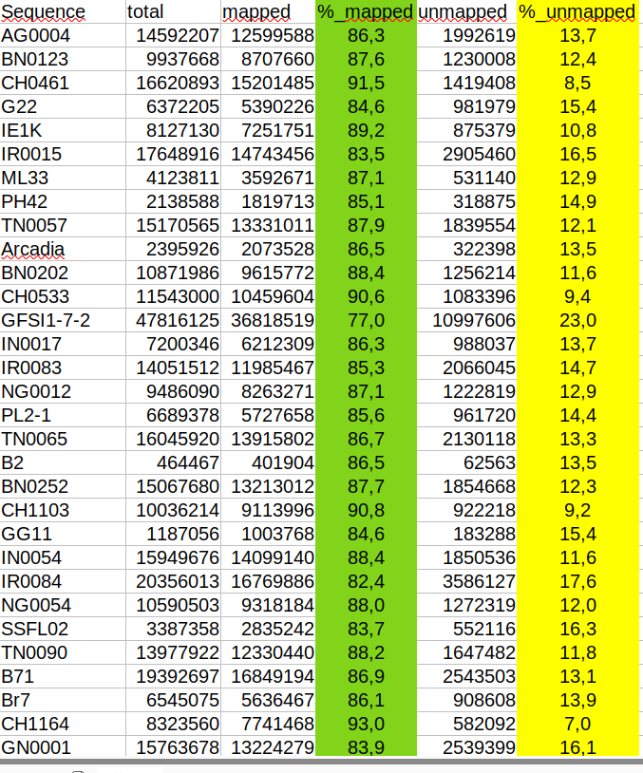
RESULTS & DISCUSSION (2/9)
MAPPING
Mapped reads = 77% to 93% and Unmapped reads= 7% to 23 %
(successfully alignment, good quality and relevance of the sequencing.)
12

Slide 14
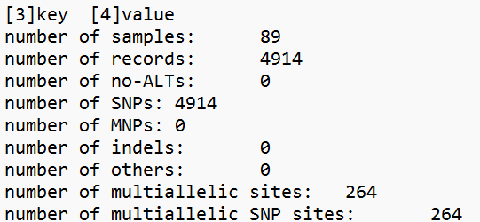
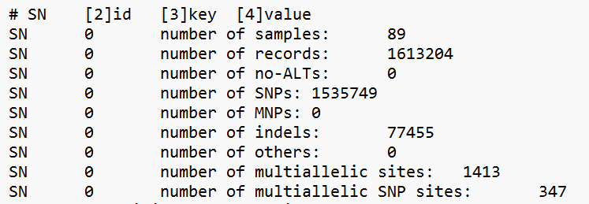

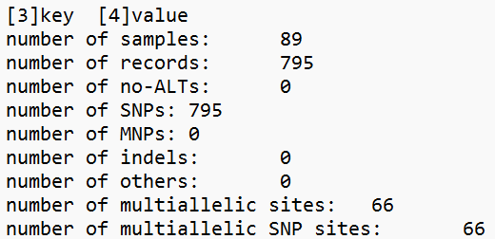
RESULTS & DISCUSSION (3/9)
SNP CALLING & FILTERING
Less stringent mode SNP filtering
MAF = 0.05
MISS = 0.95
QUAL= 5000
Filter 1
Filter parameter
Allele frequency
Mean depth per individual
Mean depth per site
Site quality
Proportion of missing data per individu
Heterozygosity and inbreeding coefficient per individual
R
Raw SNP calling
String mode SNP filtering
MAF = 0.1
MISS = 0.9
QUAL= 19000
Filter 2
13

Slide 15
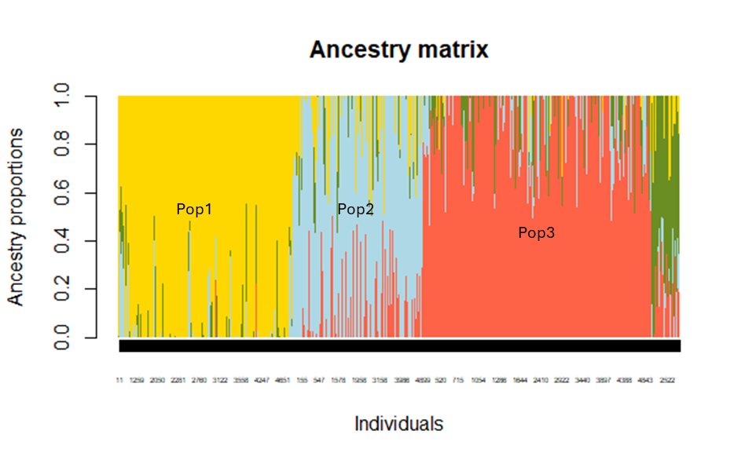

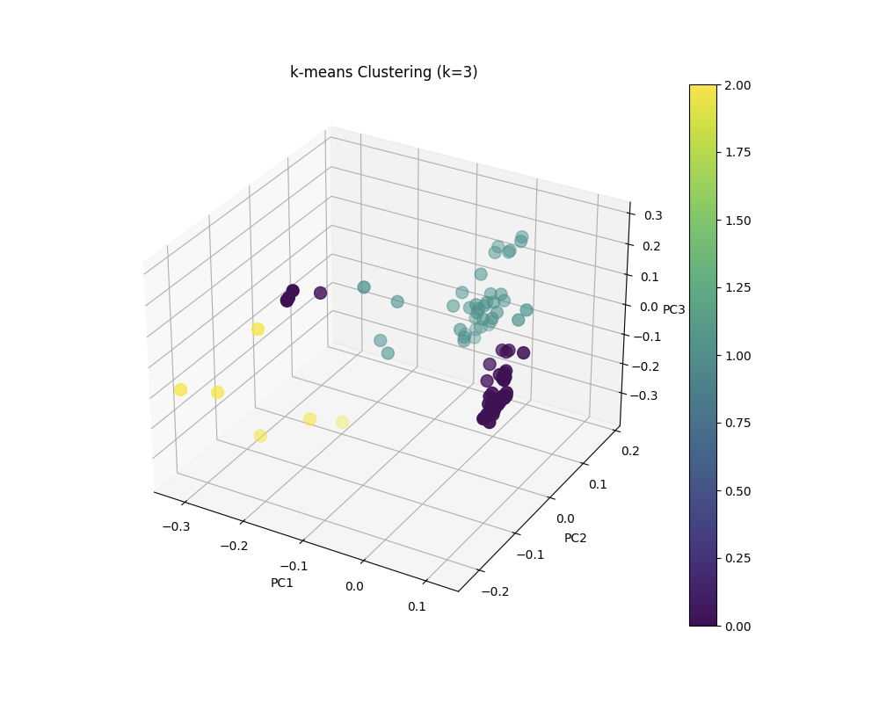
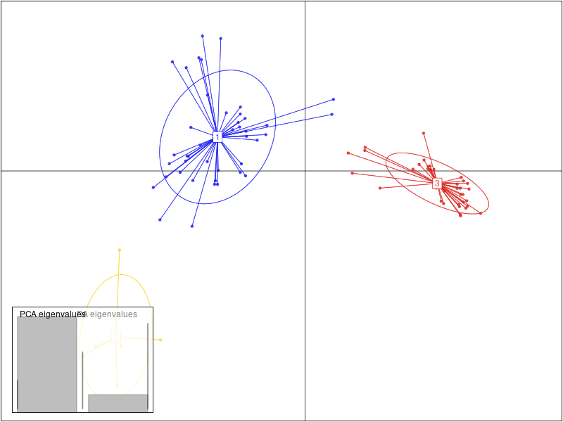
RESULTS & DISCUSSION (4/9)
DAPC & PCA using Total SNPs
Figure 3 : (a) A DAPC plot showing 3 clusters; (b) PCA plot with k-means clustering (k=3)
14

Slide 16
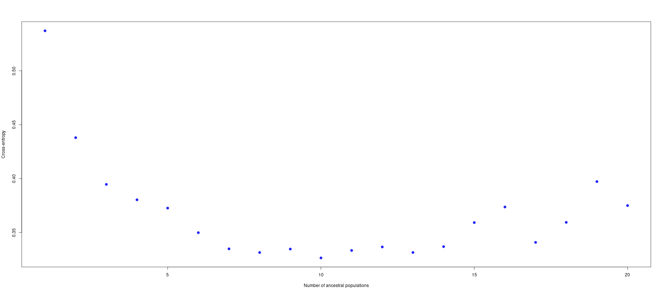
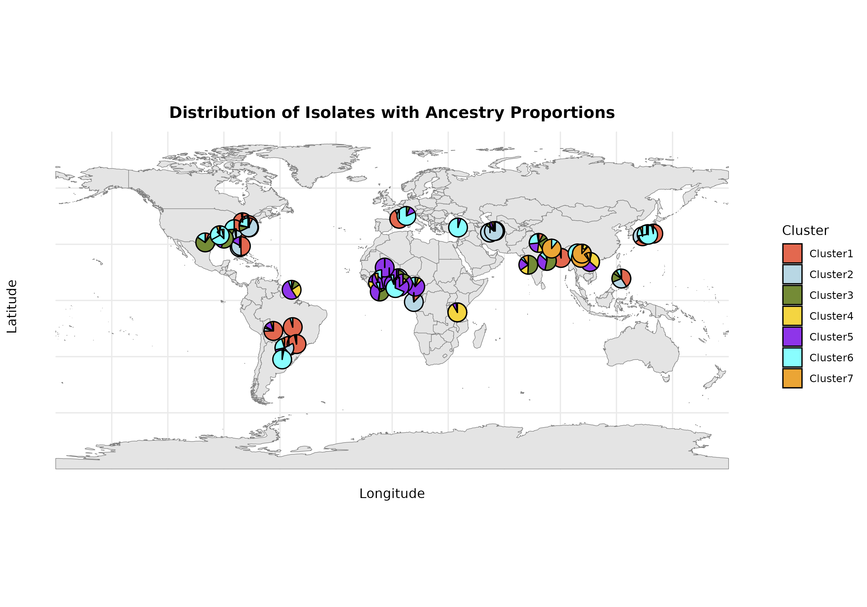
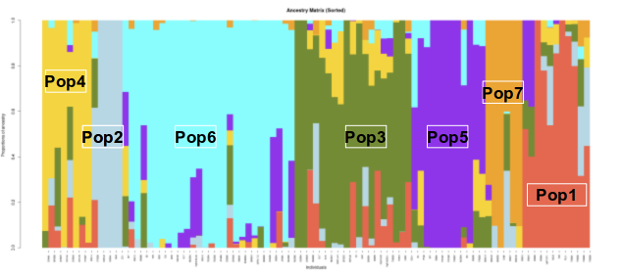
RESULTS & DISCUSSION (5/9)
GENETIC STRUCTURE using R LEA package (snmf function)
String mode SNP filtering
The optimal K = 7 (Evanno's method)
c
Figure 4 : (a) A plot of cross-entropy versus the number of ancestral populations K,, where K= 1-20 (b) graphical display of the population structure of M.Oryzae with stringent filtering ( SNP_filter :795)); (c) Map showing distribution of isolates with Ancestry proportions
15

Slide 17
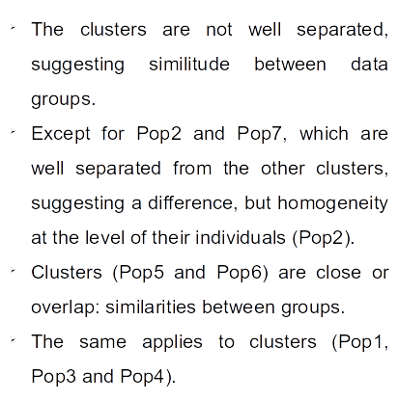
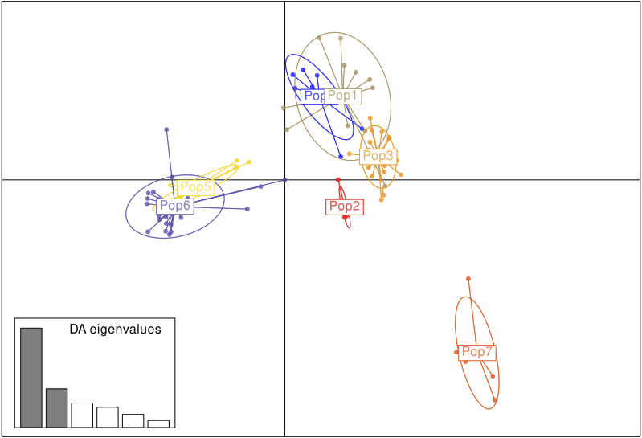
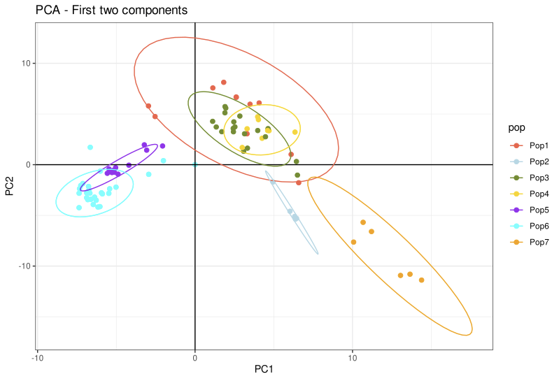
RESULTS & DISCUSSION (6/9)
String mode SNP filtering
DAPC & PCA using filtering SNPs
a
b
Figure 5 : DAPC (a) and PCA (b) to examine the number of clusters or groups. Individuals with the same color belong to the same group. DAPC & PCA generated by package R adegenet and custom python script
16

Slide 18
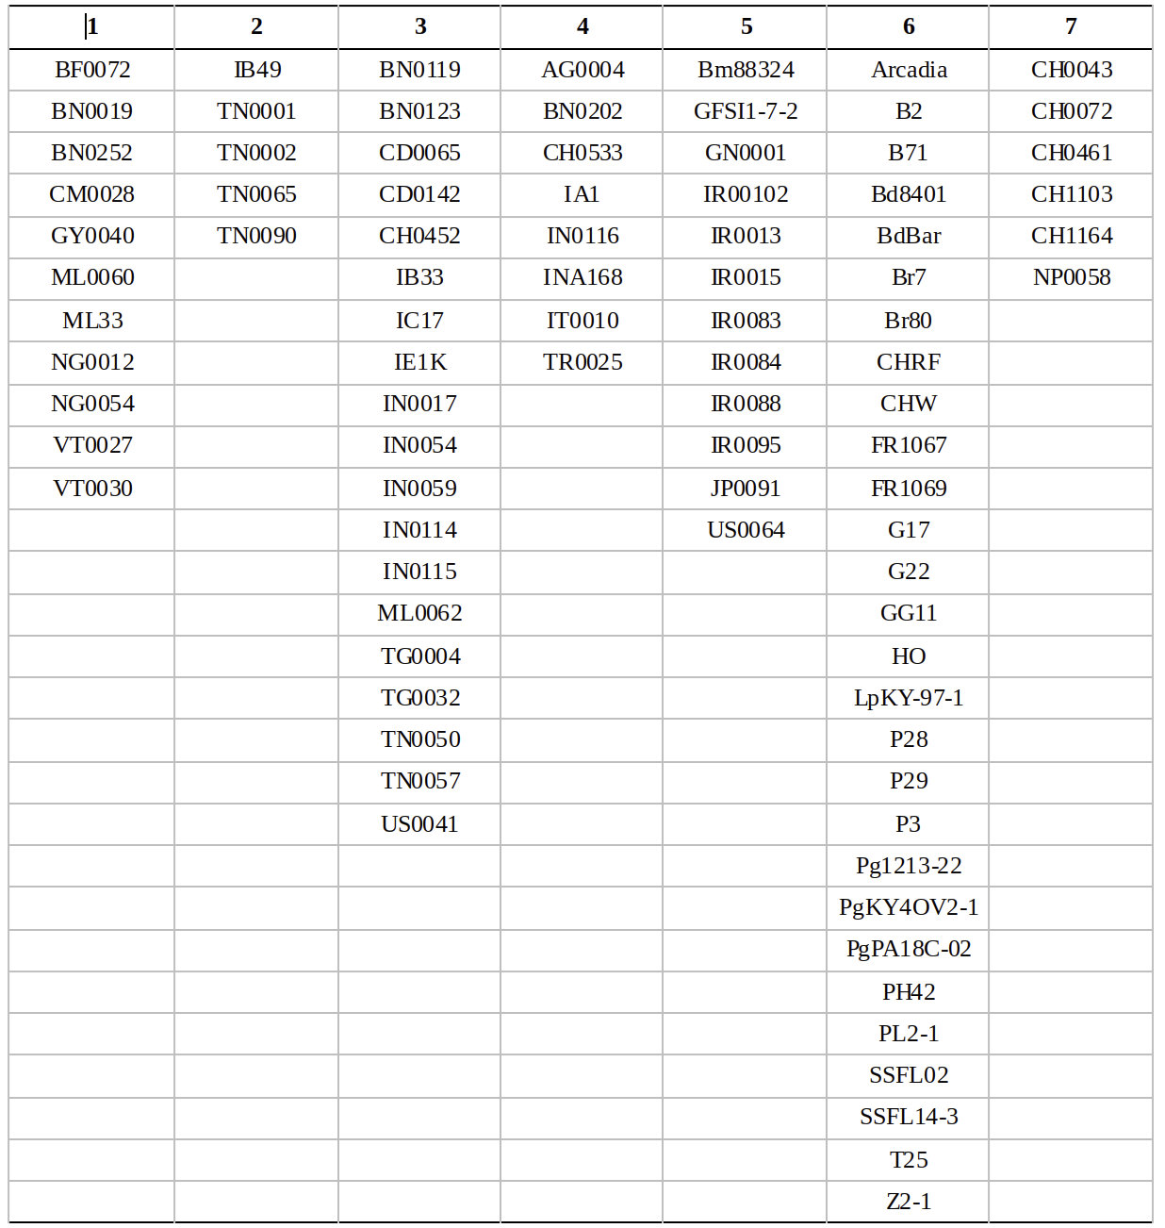
RESULTS & DISCUSSION (7/9)
String mode SNP filtering
17
Figure 6 : Phylogenetic tree

Slide 19
RESULTS & DISCUSSION (8/9)
String mode SNP filtering
Genetic diversity reduced among M. oryzae isolates
Correlation observed between pathogen and host, although relatively small
relatively small genetic differences between isolates remain
regardless of country of origin
Strong genetic proximity between rice isolates
Isolates from other hosts also tend to form distinct groups.
Not validating the existence of well-defined cryptic species within M. oryzae
These observations suggest that the host plays a key role in structuring M. oryzae populations,
but with no marked separation between countries
18

Slide 20
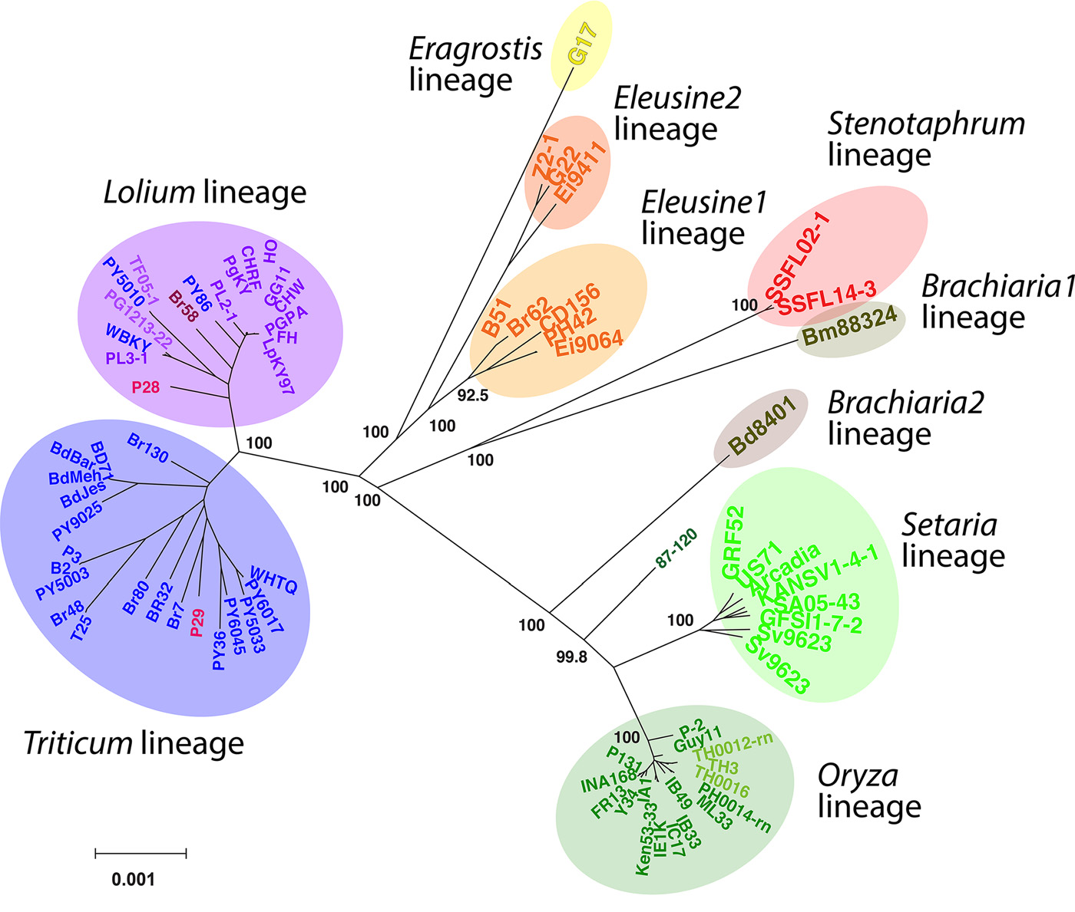
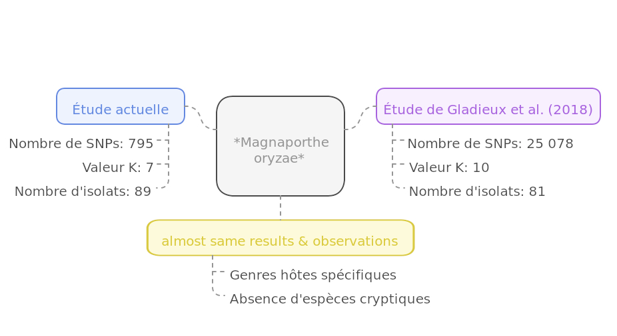
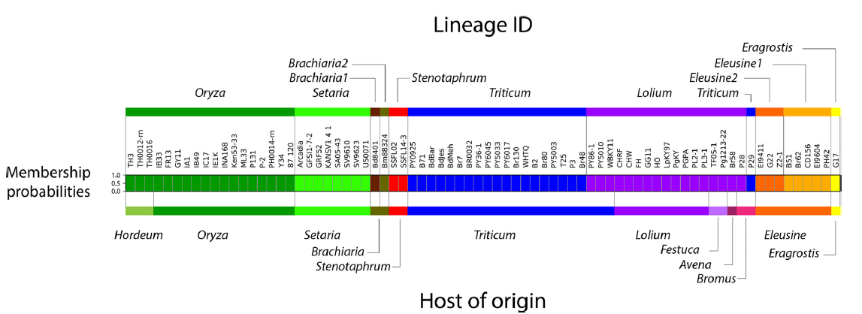
RESULTS & DISCUSSION (9/9)
19

Slide 21
CHALLENGES
Lack of time for optimal management of different steps
limits the depth of certain analyses and the quality
New and complex topic to understand
considerable time for learning and experimentation
Multiplicity of research axes with SNPs
risk of dispersing efforts, potentially compromising the depth of priority analyses.
<numéro>

Slide 22

CONCLUSION (1/2)
The strategy adopted is different from that of the 2 publications, but the results are the same.
It is very useful to perform different strategies to confirm a result
The objective of this tutored project was achieved
Production of a Github page
(https://github.com/estelp/Mentoring_Project/tree/main)
Other aspects remain to be explored to better address objectives of this project
21

Slide 23
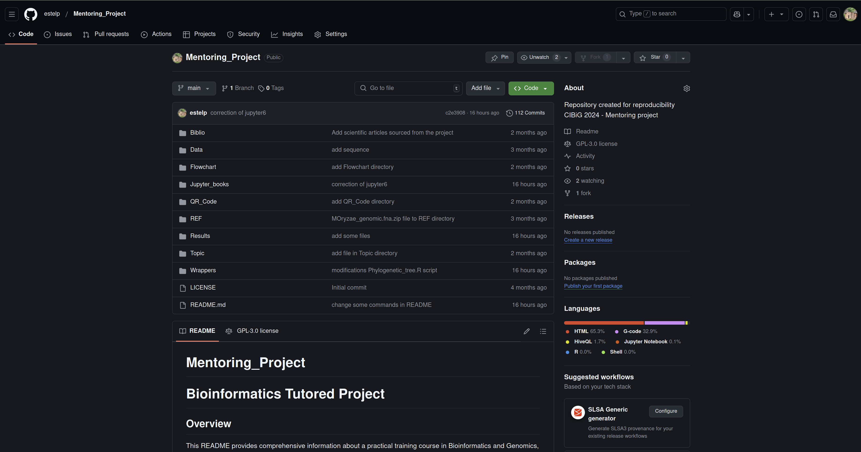
CONCLUSION (2/2)
<numéro>

Slide 24
PERSPECTIVES
Explore other aspects of the study
Perform mapping
Optimize SNP filtering
Organize and improve the GitHub repository
Extend the project to produce a Snakefile
<numéro>

Slide 25
THANKS YOU FOR YOUR ATTENTION
24

